Slide 1

Линейный штраф (d = 10)
 |  | A | T | G | A | G | T | C | T | C | T
 | 0 | -10 | -20 | -30 | -40 | -50 | -60 | -70 | -80 | -90 | -100
C | -10 | ↘ -4 | → -14 | → -24 | → -34 | → -44 | → -54 | ↘ -55 | → -65 | → -75 | → -85
T | -20 | ↓ -14 | ↘ 1 | → -9 | → -19 | → -29 | ↘ -39 | → -49 | ↘ -50 | → -60 | ↘ -70
G | -30 | ↓ -24 | ↓ -9 | ↘ 6 | → -4 | → -14 | → -24 | → -34 | → -44 | → -54 | → -64
T | -40 | ↓ -34 | ↘ -19 | ↓ -4 | ↘ 2 | ↘ -8 | ↘ -9 | → -19 | ↘ -29 | → -39 | ↘ -49
C | -50 | ↓ -44 | ↘ -29 | ↓ -14 | ↘ -8 | ↘ -2 | ↘ -12 | ↘ -4 | → -14 | ↘ -24 | → -34
T | -60 | ↓ -54 | ↘ -39 | ↓ -24 | ↓ -18 | ↘ -12 | ↘ 3 | → -7 | ↘ 1 | → -9 | ↘ -19
C | -70 | ↓ -64 | ↓ -49 | ↓ -34 | ↘ -28 | ↘ -22 | ↓ -7 | ↘ 8 | → -2 | ↘ 6 | → -4
C | -80 | ↓ -74 | ↓ -59 | ↓ -44 | ↓ -38 | ↓ -32 | ↓ -17 | ↘-2 | ↘ 4 | ↘ 3 | ↘ 2
T | -90 | ↓ -84 | ↓ -69 | ↓ -54 | ↓ -48 | ↓ -42 | ↓ -27 | ↓ -12 | ↘ 3 | ↘ 0 | ↘ 8
G | -100 | ↓ -94 | ↓ -79 | ↓ -64 | ↓ -58 | ↘ -43 | ↓ -37 | ↓ -22 | ↓ -7 | ↘ -1 | ↓ -2
CTGTCTC-CTG
ATGAGTCTCT-

Slide 2
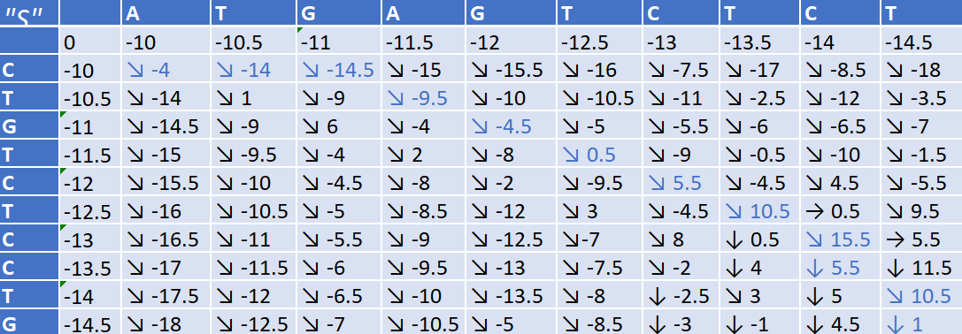
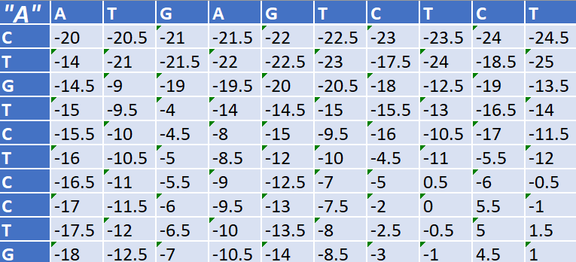
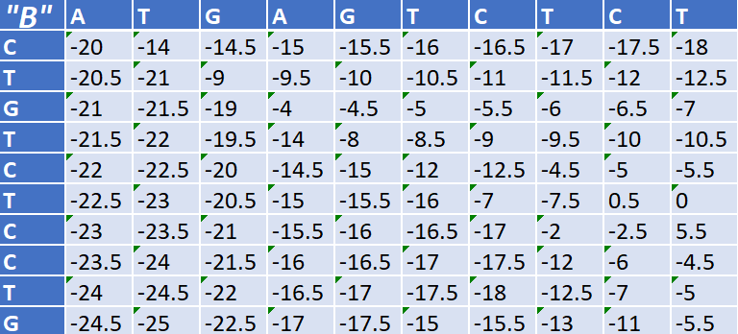

Аффинный штраф (d = 10, e = 0.5)
C--TGTCTCCTG
ATGAGTCTC-T-

Slide 3
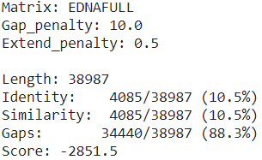
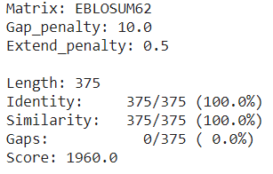
Задание 2
 | Homo sapiens | Mus musculus
Ген | Ensembl | Ensembl
Белок | UniProt | UniProt

